Slide 1

Lecture 15
Lecture
  Power Spectrum Estimation
  Non-parametric System Identification
  Random Number Generation

Slide 2
Outline
Motivation
Review of Probability Theory
Theoretical Background
  Auto/Cross-correlation
  Power Spectrum
  LTI Systems with random inputs
Power Spectrum Estimation
  Periodogram
  Auto-correlation Sequence
Random Number Generator

Slide 3
Motivation
FFT is an useful tool in signal processing. However two practical issues have to be taken into account when we apply FFT to do spectral analysis.
  Noise effects
  Finite length signals

Slide 4
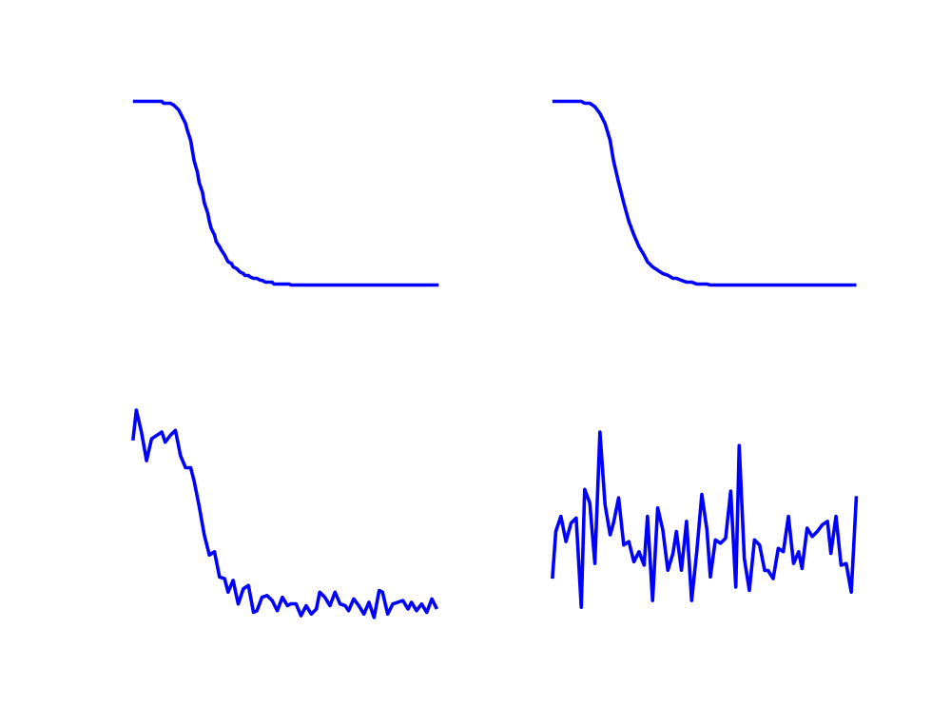
Noise Effect
e(k)
δ(k)
y(k)
H(e^{jω})
e(k) ~ N(0,σ²)
Gaussian distribution with zero mean and variance σ²

Slide 5
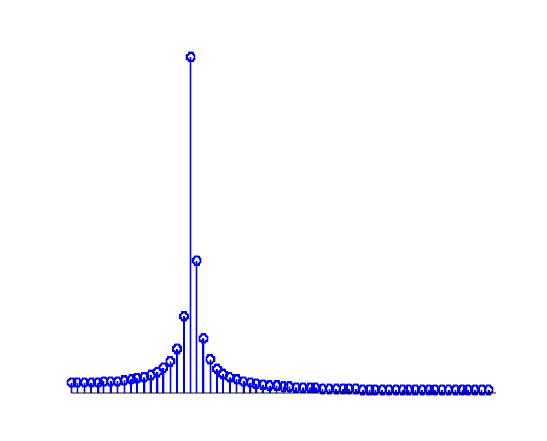
Finite Length Signals
cos(ω₀n) ↔ πδ(ω-ω₀) + πδ(ω+ω₀), -π≤ω< π
Its FFT is not an impulse! Why?

Slide 6
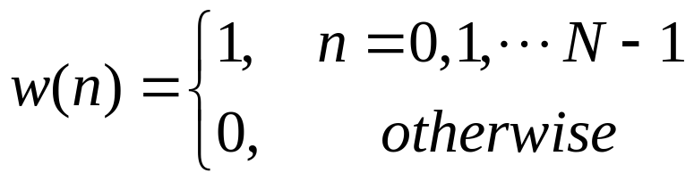
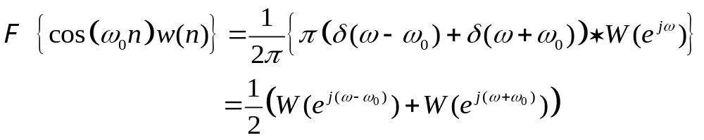
The Effect of Windowing
Since the length of the signal is finite, we actually take Fourier transform of the windowed signal x_{w}(n)=cos(ω₀n)w(n), where w(n) is a rectangular window.

Slide 7
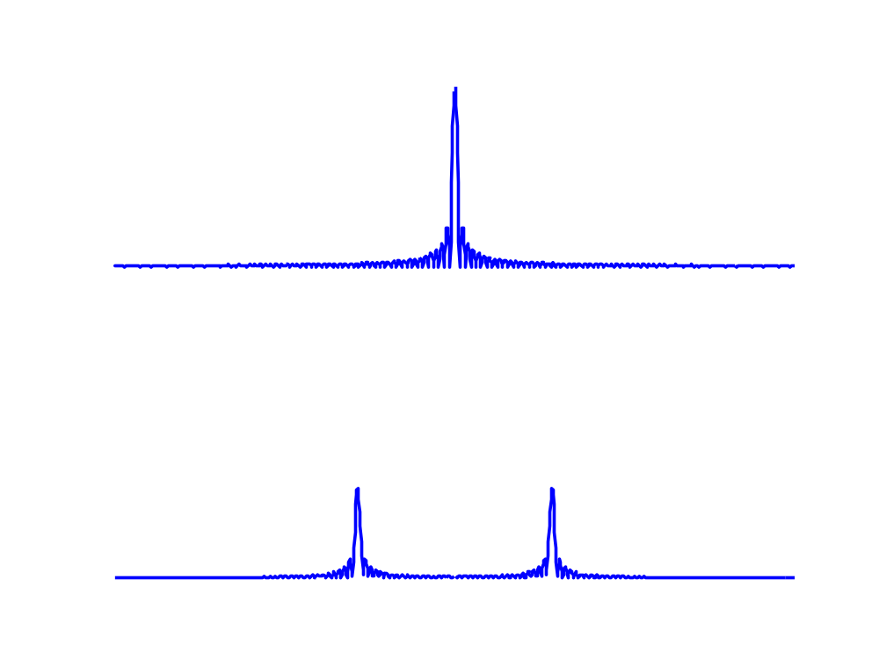

Slide 8
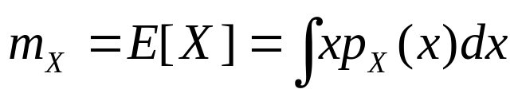
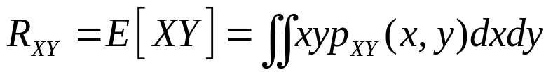
Random Variables
Mean (Expected Value) and Variance
  Let X be a random variable with probability density function p_{X}(x), then the mean and variance of X are defined as follows:
Correlation and Covariance
  Let X and Y be random variables with joint probability density function p_{XY}(x,y). The correlation and covariance of X and Y are
Mean:
Variance:
Correlation:
Covariance:

Slide 9
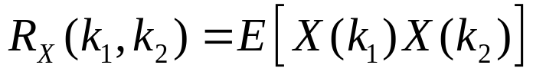
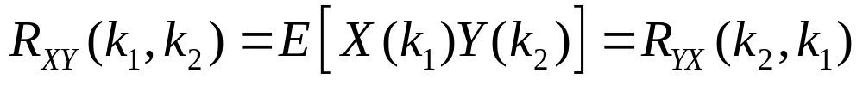
Stochastic Process
A stochastic process is a sequence of random variables.
  X(k), Y(k) are random variables, k∈Z
Auto/Cross-correlation
  (Auto)-correlation function of X:
  Cross-correlation function of X and Y:

Slide 10
Stationary Stochastic Process
The statistic properties of a stationary stochastic process do not vary with time.
X(k) is a wide-sense stationary (w.s.s.) stochastic process if
  m_{x}(k)=m_{x}, for all k, and
  R_{x}(k₁,k₂) = R_{x}(k₂-k₁), for all k₁ and k₂
If X(k) and Y(k) are w.s.s. stochastic process, then
  R_{xY}(k₁,k₂) = R_{xY}(k₂-k₁), for all k₁ and k₂

Slide 11
Properties of R_{x}(τ)
R_{x}(0)=E[X(k)²] ≥ 0
R_{x}(τ)=R_{x}(-τ) for all τ
  R_{x}(τ)=E[ X(k)X(k+τ) ] = E[ X(k+τ)X(k) ] = R_{x}(-τ)
R_{x}(0) ≥ |R_{x}(k)| for all k
  0 ≤ E[ |X(n)-X(n+k)|²]
  = E[X(n)²]- 2E[| X(n)X(n+k) |] + E[X(n+k)²]
  ≤ 2( R_{x}(0) - |R_{x}(k)| )
R_{XY}(τ)=R_{YX}(-τ)

Slide 12
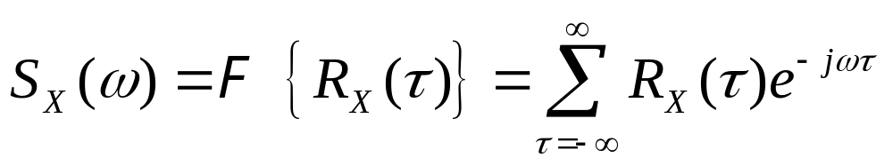
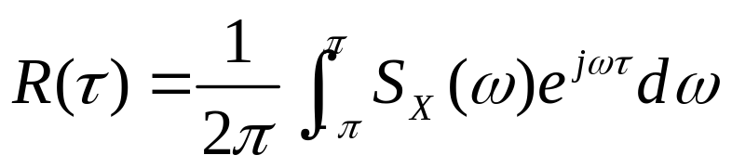
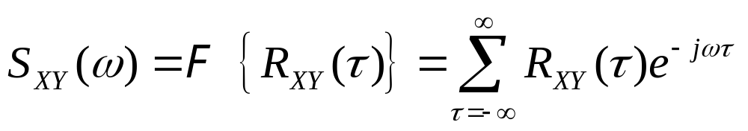
Power Spectrum
Definition: Fourier Transform of R_{x}(τ)
Inverse Formula:
Cross-Power Spectrum

Slide 13
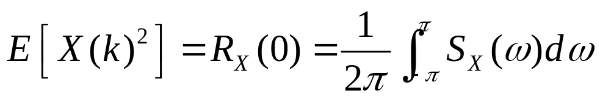
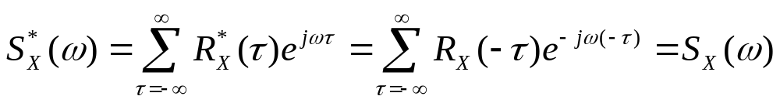
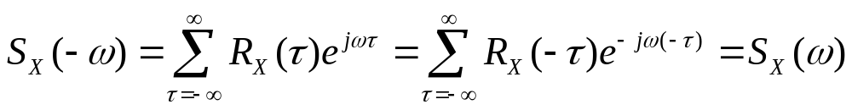
Properties of the Power Spectrum
Power of X:
S_{XY}(ω)= S*_{YX}(ω)
S_{X}(ω) is a non-negative, real, and even function
  Real
  Even
  Non-negative (see reference)

Slide 14
White Noise
A stochastic process X(k) is said to be a white noise if
  R_{X}(k)=σ² δ(k), or equivalently
  S_{x}(ω)= σ² for all ω
Two distinct samples of a white noise are uncorrelated.
A white noise consists of all frequency components with equal weights.

Slide 15
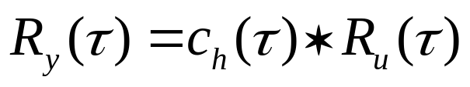
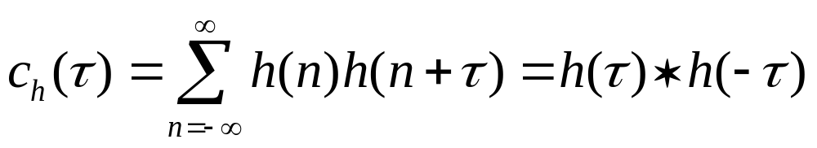
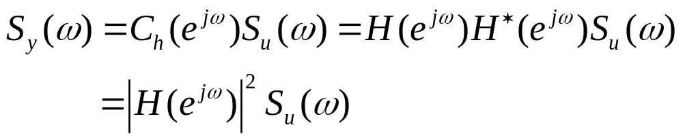
Power Spectrum of LTI Systems
u(k)
y(k)
LTI Systems:
H(e^{jω})
⇒
(*) (c.f. next slide)
where
Then

Slide 16
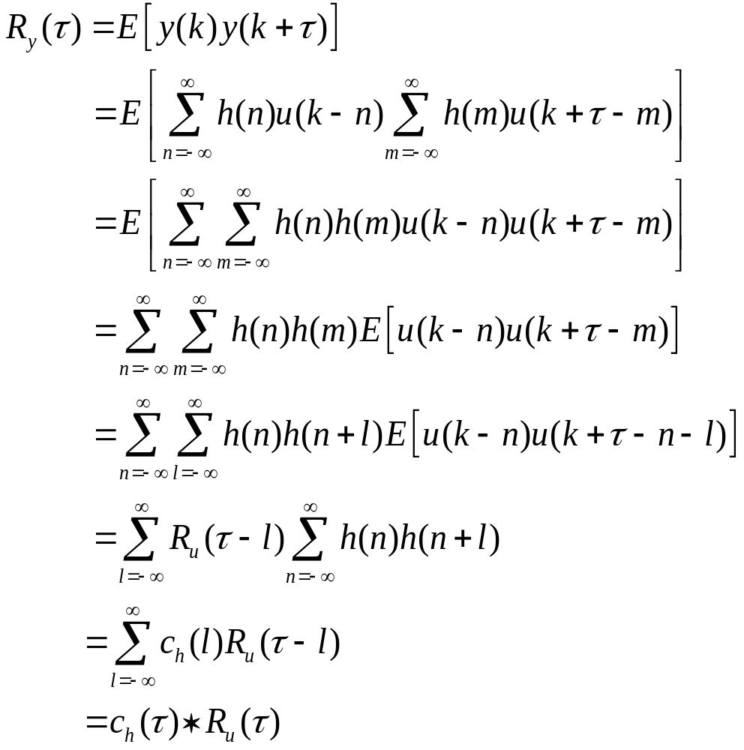
Proof of (*)

Slide 17
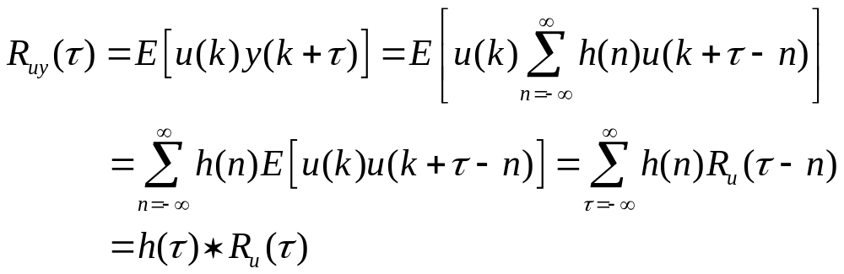
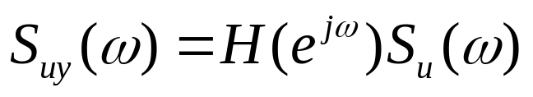
Cross-Spectrum of LTI Systems
On the other hand,
Hence
This is useful for estimating H(e^{jω}) from u(k) and y(k)

Slide 18
Applications
Frequency Detection
  Find frequency components of a contaminated signal
  Find harmonics of a periodic signal
System Identification
  Estimate the frequency response of an LTI system
Statistical Inference
  Find correlation between two signals

Slide 19
Power Spectrum Estimation
In practice, the power spectrum cannot be computed exactly because
  finite duration signals
  measurement noise
Two estimation methods
  Periodogram
  DFT of estimated autocorrelation sequences
What characterizes an estimation method?
  Mean (bias)
  Variance (consistency)

Slide 20


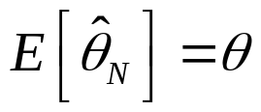
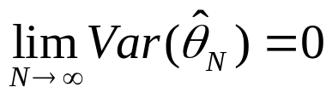
Bias v.s. Variance
Let θ be a parameter to be estimated by , where N is the number of data used in the estimation.
A statistical estimator is itself a random variable.
If , this estimator is said to be unbiased.
If , this estimator is said to be consistent.
For finite N, there is a trade-off between bias and variance.

Slide 21
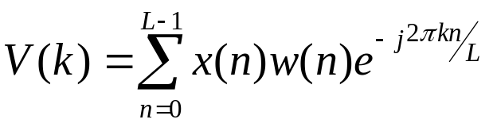
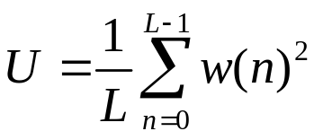
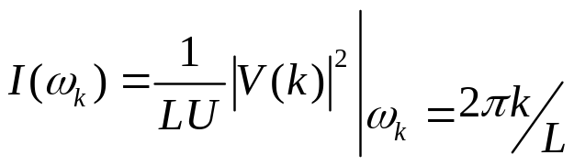
Periodogram
To estimate S_{X}(ω), let V(k) be the L-point DFT of the windowed signal w(n)x(n).
k = 0, 1, … L-1
where w(n) is an L-point window function and
The periodogram is defined as
k = 0, 1, … L-1

Slide 22
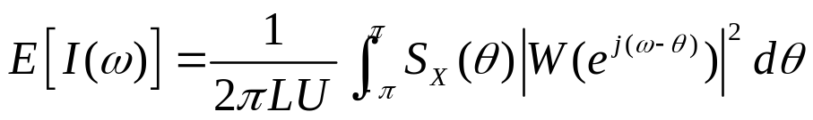

Bias and Variance of the Periodogram
Mean:
W(e^{jω}) is the Fourier transform of the window w(n)
The periodogram is a biased estimate of the power spectrum. As the window length L increases, however, E[I(ω)] approaches to S_{x}(ω)
Variance:
for large window size
The variance of I(ω) does not approaches to zero as the length of the window increases, i.e. I(ω) is not a consistent estimate of S_{x}(ω)

Slide 23

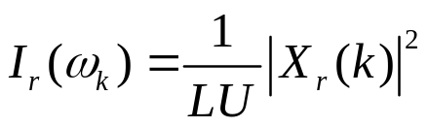
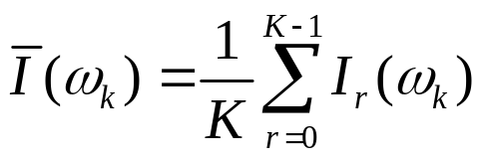
Periodogram Averaging
For better estimation, average periodograms over data segments.
Let
0 ≤ n ≤ L-1, R≤L
Periodogram of the r-th segment
X_{r}(k) is the L-point DFT of x_{r}(n)
Averaged periodogram
R
L
x
L
n

Slide 24
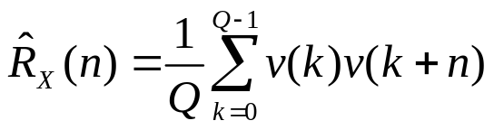
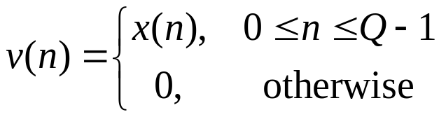
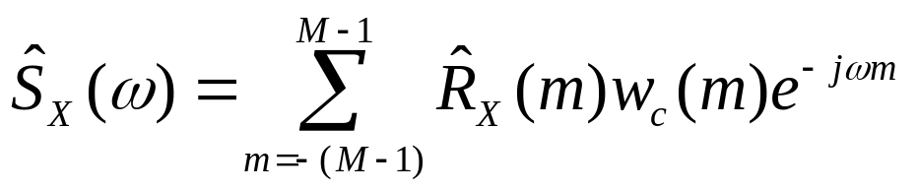
Estimation of Autocorrelation Sequences
Estimated autocorrelation sequence
|n|≤Q-1
where
w_{c}(m) is a (2M-1)-point symmetric window

Slide 25
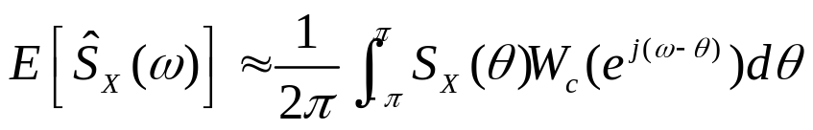
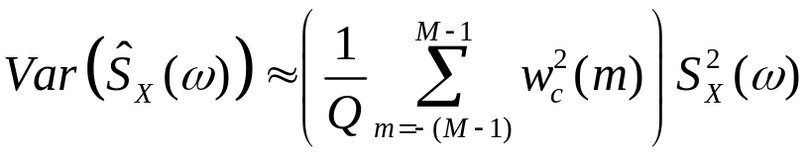
Bias and Variance
Mean:
W_{c}(e^{jω}) is the Fourier transform of the window w_{c}(n)
It is a biased estimate. As the window length M increases, however, the estimate becomes unbiased.
Variance:
A small M results in small variance, but large bias.

Slide 26
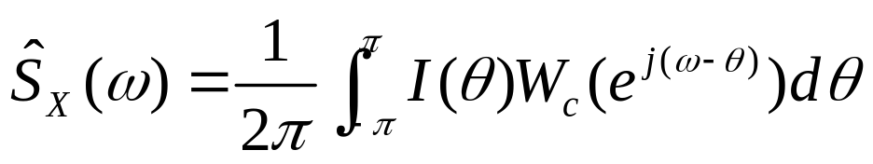
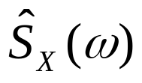
Remarks
S_{xY}(ω) can be estimated in the same way.
  Estimate R_{XY}(n)
  Take DFT of the windowed estimate of R_{XY}(n)
Relation between the periodogram and this estimator:
The non-negativity property of is not guaranteed unless W_{c}(e^{jω})≥0, which is satisfied by the triangular window.

Slide 27
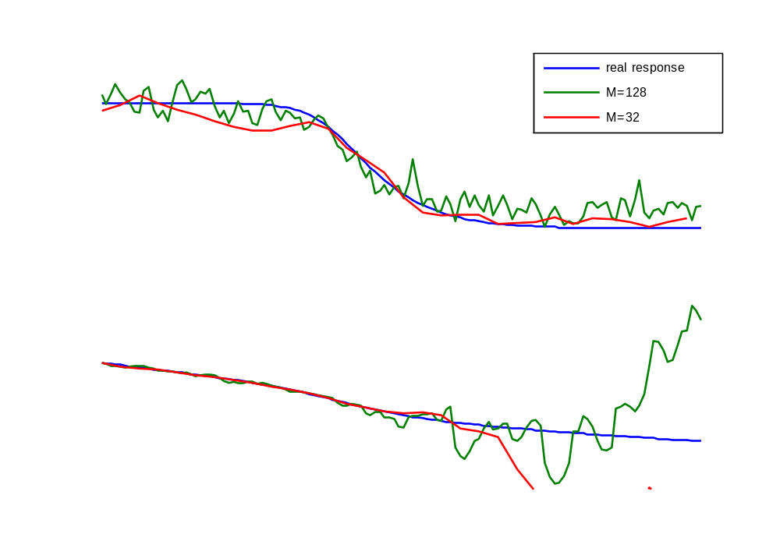
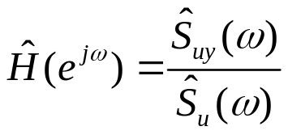
Example: Non-parametric System Identification
e(k)
u(k)
y(k)
H(e^{jω})
Collect u(k) and y(k), estimate H(e^{jω})

Slide 28
Final Project
Implement either power spectrum estimator
Input a triangular or square wave to the DSP board, record it and add perturbations (noise) to it.
  Identify the harmonics. (How many harmonic frequencies can you identify?)
  Compute the ratio between two harmonics. Compare the result with the theoretical value.
  Repeat the process for different sizes of perturbations.
Design a digital filter H(z⁻¹), give input u(k) and find its (noisy) output y(k).
  What kind of input should you use?
  Estimate H(e^{jω})
  Repeat the process for different window sizes and noise levels. Compare the results.

Slide 29
How to Generate Random Signals?
Generate random signals based on “intrinsic” random processes:
  tossing a coin or a dice
  observing nuclear decay (if you happen to have a nuclear reactor at hand…)
Generate pseudo-random numbers
  What you need is a computer or a calculator.

Slide 30
Pseudo-Random Numbers
They “look like” random numbers, but actually are not.
They are generated through a set of deterministic (and recursive) formulas.
The initial values of the formulas are called “seeds.”
If the same seeds are used every time, you get exactly the same sequence of numbers.

Slide 31
Criteria for Evaluating the Performance of a Pseudo-Random Number Generator
Randomness
  There exists many statistical tests which help us evaluate the randomness.
Long Period
  Due to the finite precision nature of digital computers, only a finite set of numbers can be generated.
Computational Efficiency
  The generation of random numbers should be efficient in terms of time and space.
Repeatability
  The behavior of the generator should be predictable as long as the seed is given.

Slide 32
Kiss Algorithm
KISS means “Keep It Simple, Stupid.”
A number of variants of Kiss algorithms exist. Here is one version (in C language form):
/* Uniform Random Number Generator: Kiss Algorithm */
/* Three seeds are required for i, j, k respectively */
/* It returns an integer between 0 and 2³²-1 */
unsigned long i, j, k; /* long int is 32-bit long */
unsigned long kiss(void)
{
j = j ^ (j<<17); /* ^ is the bitwise XOR operator in C language */
k = (k ^ (k <<18 ) ) & 0x7FFFFFFF;
return ( (i = 69069*i+23606797)+(j^=(j>>15))+(k^=(k>>13)) );
}

Slide 33
References
A. V. Oppenheim and R. W. Schafer, Discrete-Time Signal Processing, 2nd Ed. Prentice Hall, 1999 (Chap 10)
A. Papoulis, Probability, Random Variables, and Stochastic Processes, 3rd Edi. McGraw-Hill, 1991
C. P. Robert and G. Casella, Monte Carlo Statistical Methods, 2nd Ed. Springer, 2004

Slide 34
Schedule
DSP Lab Open Hours:
  12/19 (Wed.) 12/20 (Thu.) 12/21 (Fri.)
  12/26 (Wed.) 12/27 (Thu.) 12/28 (Fri.)
  1/2 (Wed.) 1/3 (Thu.) 1/4 (Fri.)
Demonstration
  1/9 (Wed.) (6:30pm ~ 10:00pm)
  Lab opens at 6:30pm
Final Report Due Date: 1/9 (Wed.)
Reports of all labs (including the final project) must be submitted before 10pm, Jan. 9, 2008. This is a hard dead line. No exception!

